Slide 1
Economics 144 Economic Forecasting
Lecture 10
A Forecasting Model with Trend, Seasonal, and Cyclical Components
Dr. Randall R. Rojas

Slide 2
Today’s Class
Full model: Trend + Seasonal + Cycle(s)
R Example
Recursive Estimation Procedures

Slide 3
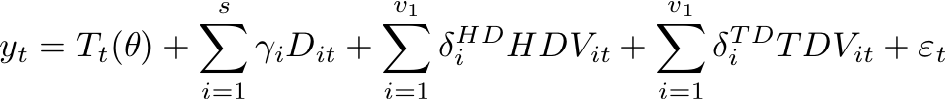


Full Model 1 of 2
The full model includes a trend, seasonal dummies, and cyclical dynamics.
Trend
Seasonality
Cycles
Innovation

Slide 4


Full Model 2 of 2
We can now construct the h-step-ahead point forecast at time T, y_{T+h,T} .
Project the r.h.s variables on Ω_{t} .
Make the point forecast operational by replacing unknown
parameters with estimates.
Confidence Interval
Density Forecast

Slide 5
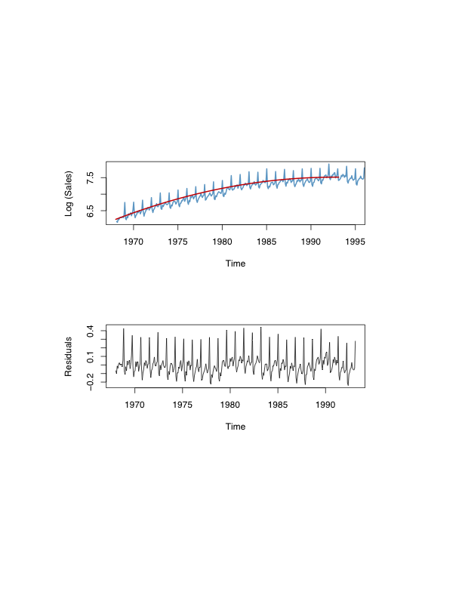
Liquor Sales Example 1 of 7
Quadratic Trend Model
Strong residual seasonality
(maybe even cycles)

Slide 6
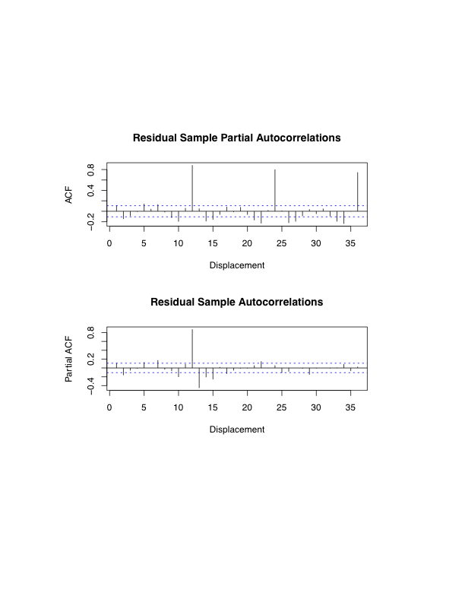
Liquor Sales Example 2 of 7
Bartlett Bands
S-AR(1)
with s =12
Indicate the presence
of cyclical dynamics.

Slide 7
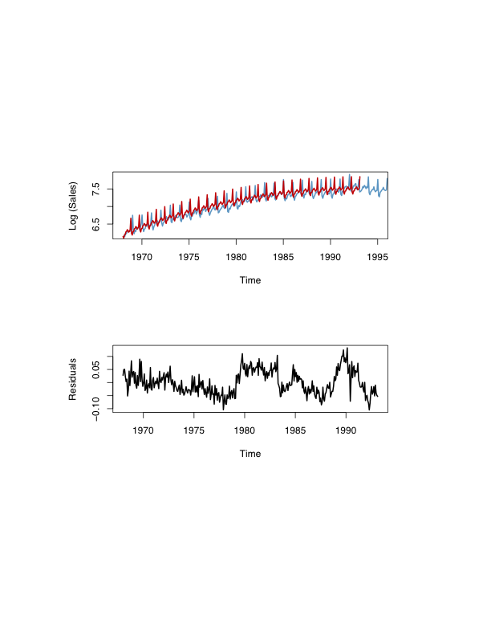
Liquor Sales Example 3 of 7
Quadratic Trend Model
+Seasonality
No seasonality but
strong serial correlation
Highly Predictable!

Slide 8
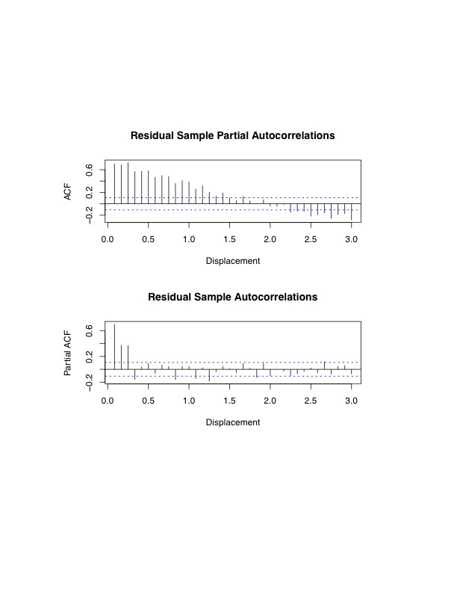
Liquor Sales Example 4 of 7
Residual Sample Autocorrelations
Residual Sample Partial Autocorrelations
Cutoff at 3 → AR(3) model

Slide 9
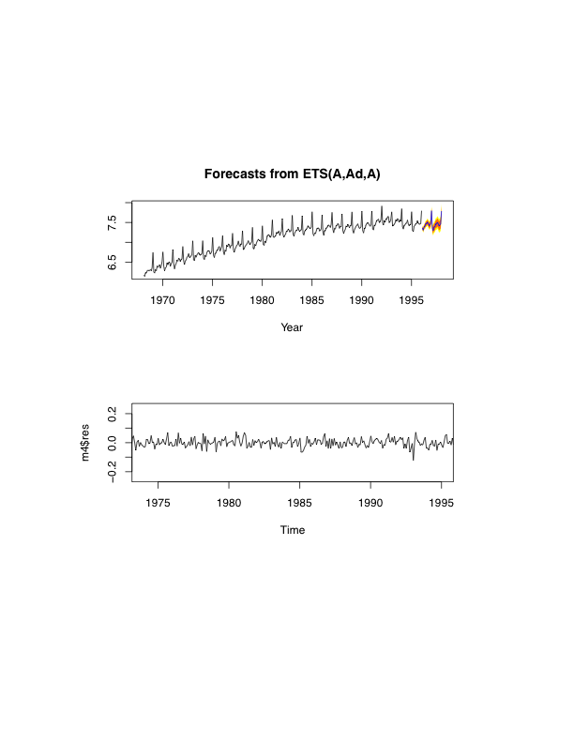
Liquor Sales Example 5 of 7
Log (sales)
No structure left in the residuals!
Residuals

Slide 10
Recursive Estimation Procedures
Strategy:
Start with a small sample of data
Estimate a model
Add an observation
Re-estimate the model
Continue until all data are used
Useful for forecasting, stability assessment, and model selection.

Slide 11
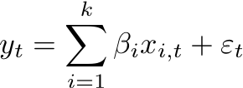


Recursive Parameter Estimation and Recursive Residuals 1 of 2
Recursive estimates provide information about parameter stability.
Linear Model: ,
If the model contains k parameters, start with first k obs and estimate the model, the k+1,… → recursive parameter estimates for t=k,…T and i=1,…,k.

Slide 12
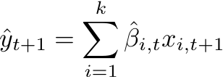



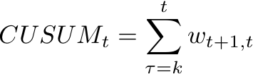
Recursive Parameter Estimation and Recursive Residuals 2 of 2
1-step-ahead-forecast:
Recursive residuals: where r_{t} >1 for all t. Note: r_{t} depends on the data.
Standardized Recursive Residuals: where
Cumulative Sum: where
t =k,…,T-1

Slide 13
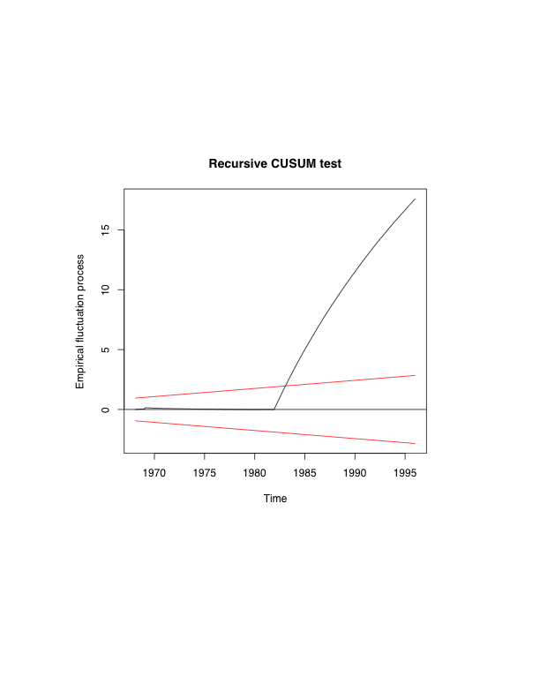
Liquor Sales Example 6 of 7
Cumulative Sum
Used for parameter stability
Variance grows as we include
more observations
What happened?

Slide 14
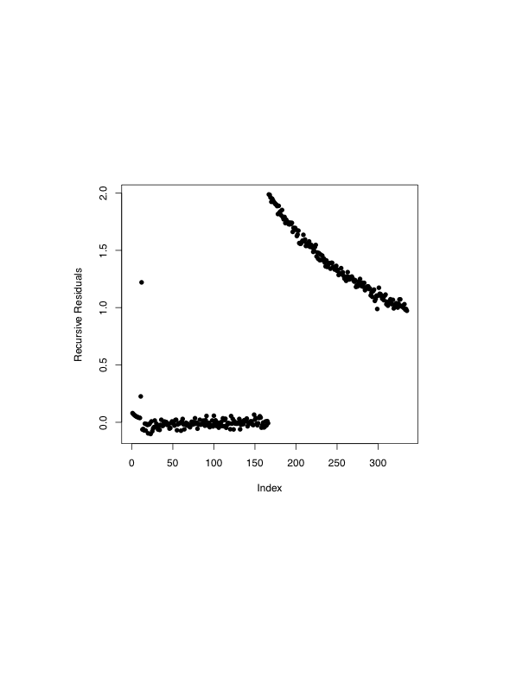
Liquor Sales Example 7 of 7
Breaking Parameter
Model

Slide 15
Model Selection Based on Simulated Forecasting Performance 1 of 2
Cross Validation: Select among N forecasting models.
Start with model 1
Estimate it using all data observations except the first
Use it to forecast the first observation
Compute the squared forecast error.
Continue estimating the model with one observation deleted and then using the estimated model to forecast the deleted observation until each observation has been sequentially deleted.
Average the squared errors
Repeat procedure for model n =1,…,N
Select the model with the smallest squared error.

Slide 16
Model Selection Based on Simulated Forecasting Performance 2 of 2
Recursive Cross Validation:
Let the initial estimation sample run from t =1,…,T*
Let the `holdout sample’ run from t =T*+1,…,T
For each model:
Estimate the model using observations t =1,…,T*.
Use the model to forecast observation T*+1.
Compute the associated squared error.
Update the sample by 1 observation (T*+1)
Estimate the model using the updated sample t=1,…,T*+1.
Forecast observation T*+2, computed associated squared error.
Repeat previous steps until sample is exhausted.
Average the squared errors in predicting observations T*+1 through T.
Select the model with the smallest squared forecast error.

Slide 17
For Next Class
Readings about today’s class:
Chapter 10^{b}
Review Exercises / Problems:
Chapter 10^{b}: 2, 6, 7
Readings for next class:
Chapter 11^{b}

